Slide 1

UNSUPERVISED LEARNING

Slide 2


UNSUPERVISED LEARNING
Unsupervised Learning refers to all kinds of machine learning where there is no known output no sort of "labels" that we are using to predict an outcome
Rather, the algorithm is given data and asked to extract knowledge based on any patterns it is able to find
Data Squad | Unsupervised Learning

Slide 3

UNSUPERVISED LEARNING
Data Squad | Unsupervised Learning

Slide 4



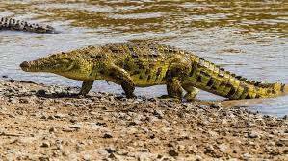
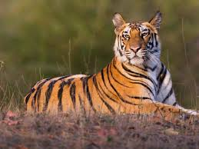

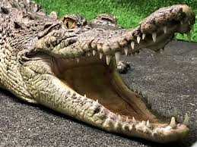
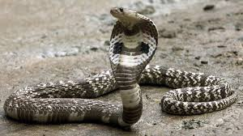
UNSUPERVISED LEARNING
Data Squad | Unsupervised Learning

Slide 5
UNSUPERVISED LEARNING
Data Squad | Unsupervised Learning

Slide 6
UNSUPERVISED LEARNING
Different clustering algorithms use different methods to define what is 'similar'
Data Squad | Unsupervised Learning

Slide 7
UNSUPERVISED LEARNING
Typical Usecases
- Topic Identification (when analysing emails, documents articles): discovers common themes or topics in emails, documents, or articles using techniques like clustering or topic modeling.
- Image Clustering: Groups similar images together based on visual features without needing labels, often used in organizing large image datasets.
- Retail basket analysis: Finds patterns in customer purchases to suggest product associations or bundles, such as “people who buy X also buy Y.”
Data Squad | Unsupervised Learning

Slide 8

UNSUPERVISED LEARNING
Clustering is the task of partitioning the dataset into groups of similarity called clusters
Clustering algorithms assign a number to each datapoint indicating which cluster it belongs to.
Data Squad | Unsupervised Learning

Slide 9
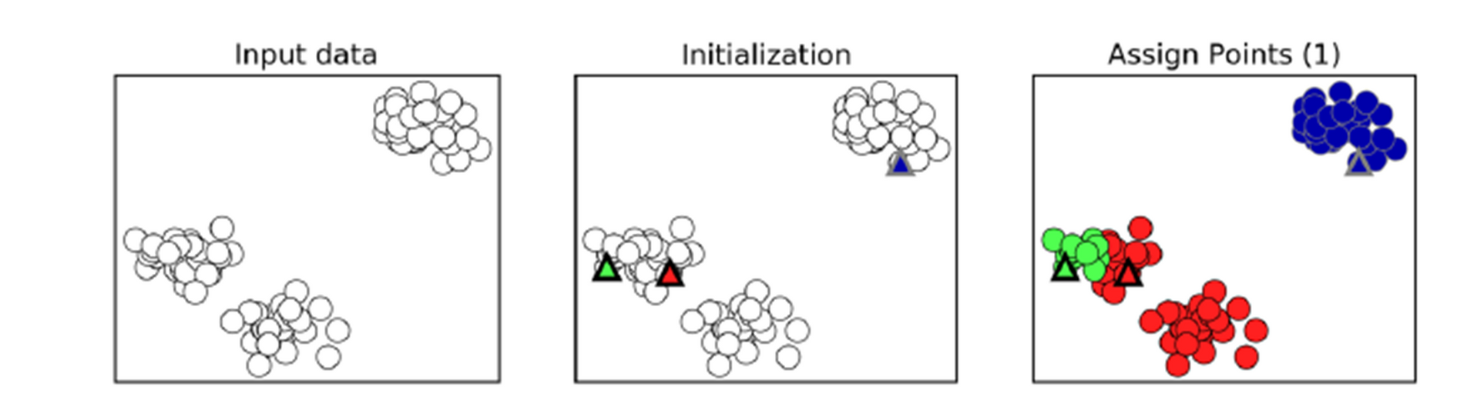
K-MEANS CLUSTERING
Data Squad | Unsupervised Learning

Slide 10
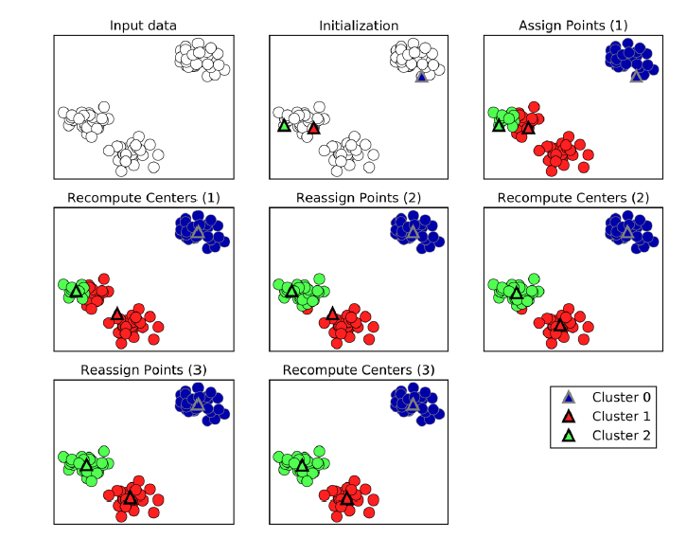
K-MEANS CLUSTERING
Data Squad | Unsupervised Learning
Notes:
Randomly select K initial cluster centers (called centroids) from the data points. These will act as the starting point for each cluster.

Slide 11
K-Means Clustering: Step-by-Step
1. Initialization
Randomly select K initial cluster centers (called centroids) from the data points. These will act as the starting point for each cluster.
2. Assign Points (1)
Each data point is assigned to the nearest centroid, typically using Euclidean distance. This creates K initial clusters.
3. Recompute Centers (1)
For each cluster, calculate the new centroid by averaging the positions (mean) of all the points assigned to that cluster.

Slide 12
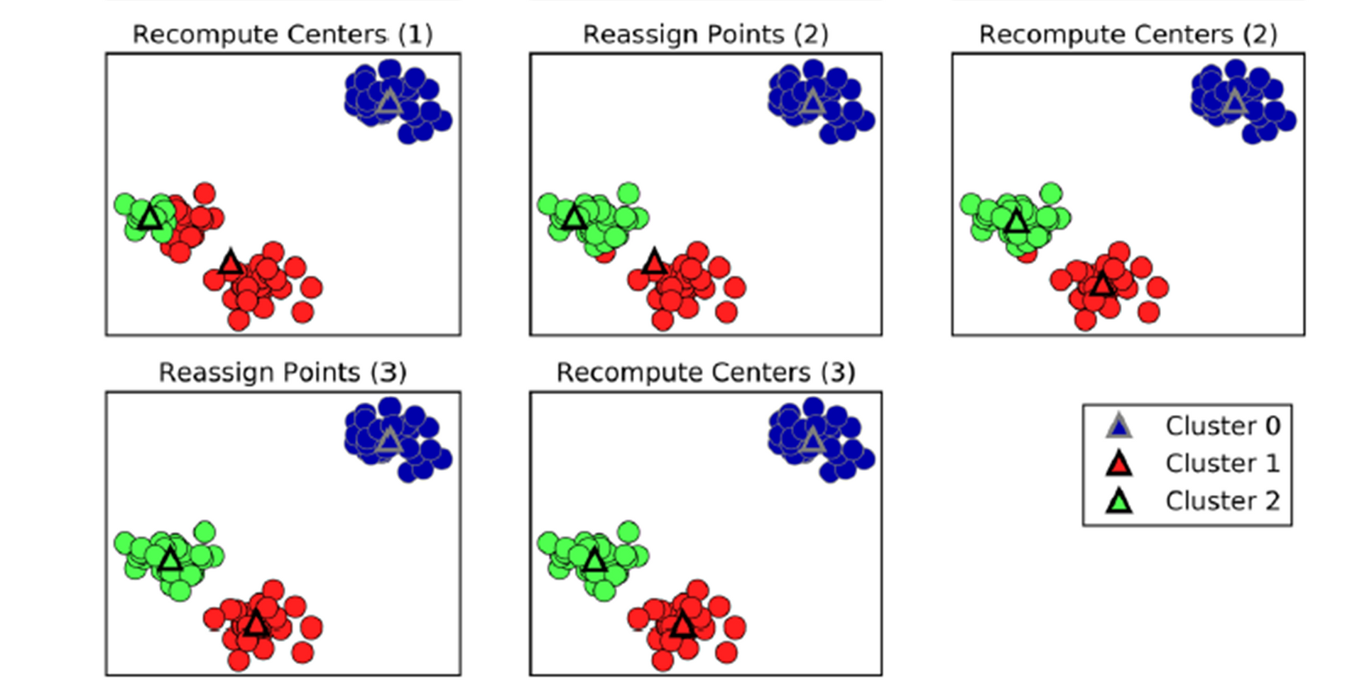
K-MEANS CLUSTERING
Data Squad | Unsupervised Learning

Slide 13
4. Reassign Points (2)
Now that the centroids have moved, reassign each data point to the nearest new centroid. ➡️ Some points may change clusters.
5. Recompute Centers (2)
Again, update the centroids by taking the mean of the newly formed clusters. ➡️ Centroids shift closer to the "true" centers of the data distribution.
6. Reassign Points (3)
Repeat the assignment step: check again which centroid is closest to each point, and reassign if necessary. ➡️ Fewer points should change clusters at this stage.
7. Recompute Centers (3)
Recalculate centroids one more time. If no points change clusters, or the centroids stop moving significantly, the algorithm converges and stops.
✅ Final Output
Stable clusters with their respective centroids.
Each data point is assigned to one cluster.

Slide 14
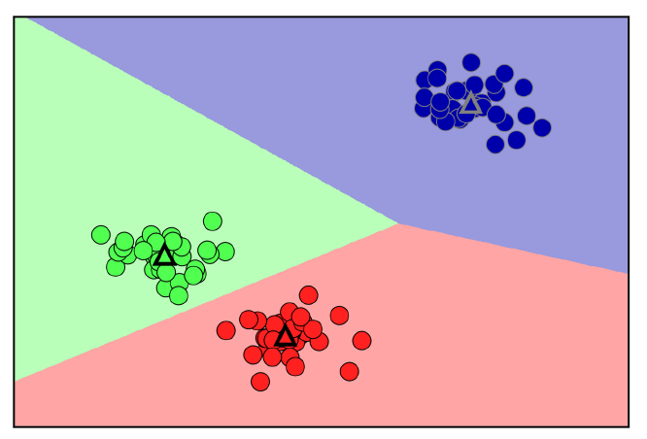
K-MEANS CLUSTERING
In the end you are left with areas that identify in which a cluster a newly assigned point would be classified.
These are known as the Voronoi Regions
Regions identify the closest centroid center to each point
Data Squad | Unsupervised Learning

Slide 15
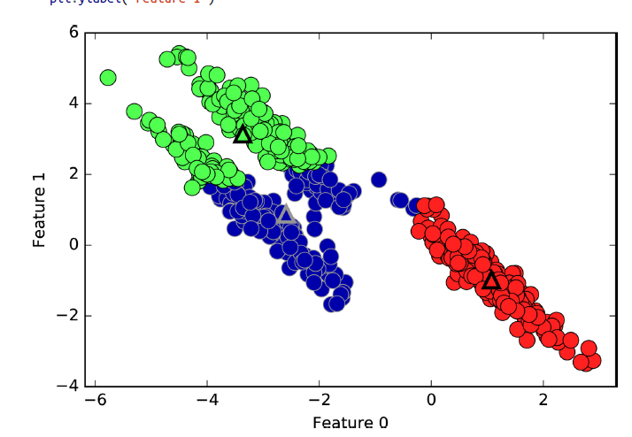
K-MEANS CLUSTERING
In this coordinate system, the clusters are found in complex shapes which makes it harder for the kmeans to correctly identify them
Data Squad | Unsupervised Learning

Slide 16

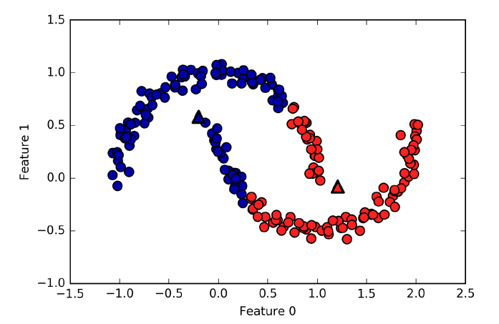
K-MEANS CLUSTERING - LIMITATIONS
Data Squad | Unsupervised Learning

Slide 17
K-Means Clustering – Limitations
Must Specify K The number of clusters (K) must be chosen in advance, which isn't always obvious.
Assumes Spherical Clusters Works poorly with clusters of irregular shapes or varying sizes.
Sensitive to Initialization Random starting points can lead to different or suboptimal results.
Affected by Outliers Outliers can distort centroids and reduce clustering accuracy.
Requires Numeric Data K-Means relies on distance calculations and can't handle categorical data directly.

Slide 18
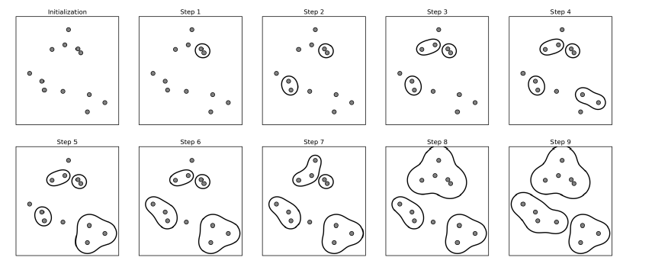
AGGLOMERATIVE CLUSTERING
Data Squad | Unsupervised Learning

Slide 19




AGGLOMERATIVE CLUSTERING
The algorithm starts by declaring each point as its own cluster
Then a criteria of merging between clusters is iteratively applied until the desired number of cluster is reached
There are several criteria of linkage that specify what are the two most similar clusters to merge
Data Squad | Ensemble Learning

Slide 20
AGGLOMERATIVE CLUSTERING
There are several criteria of linkage that specify what are the two most similar clusters to merge
ward
The default choice, ward minimizes variance within merged clusters
average
average linkage merges the two clusters that have the smallest average distance between all their points.
complete
complete linkage (also known as maximum linkage) merges the two clusters that
have the smallest maximum distance between their points.
Data Squad | Ensemble Learning

Slide 21
DBSCAN
Density Based Spatial Clustering of Applications with Noise
Does not require the user to set the number of clusters "a priori"
Is able to identify clusters of complex shapes and points that are not part of any cluster
Works by identifying regions that are "crowded" or of high density
As a consequence it looks for dense regions followed by relatively empty regions
Data Squad | Ensemble Learning

Slide 22

DBSCAN
Requires two parameters:
eps: how close points should be to each other to be considered part of a cluster
minPoints: the minumum number of points to form a dense region. for example if equals to 5 then we need at least 5 points within a eps distance to be considered a cluster
Any values that do not satisfy the density requirements are considered as outliers.
Data Squad | Ensemble Learning

Slide 23

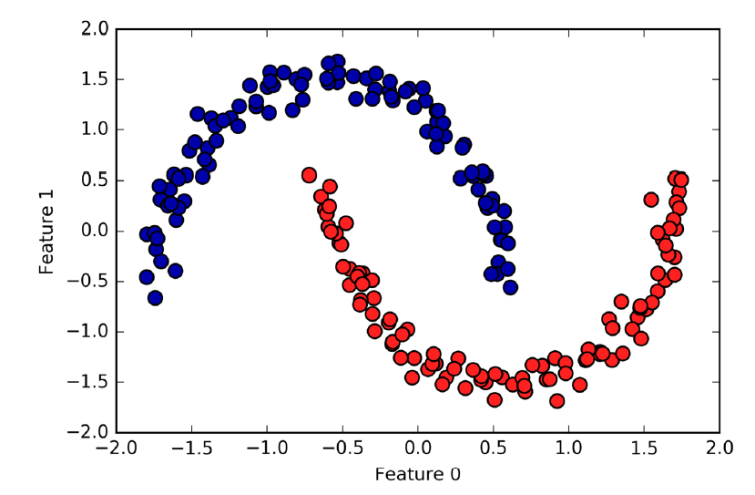
DBSCAN
Data Squad | Ensemble Learning

Slide 24
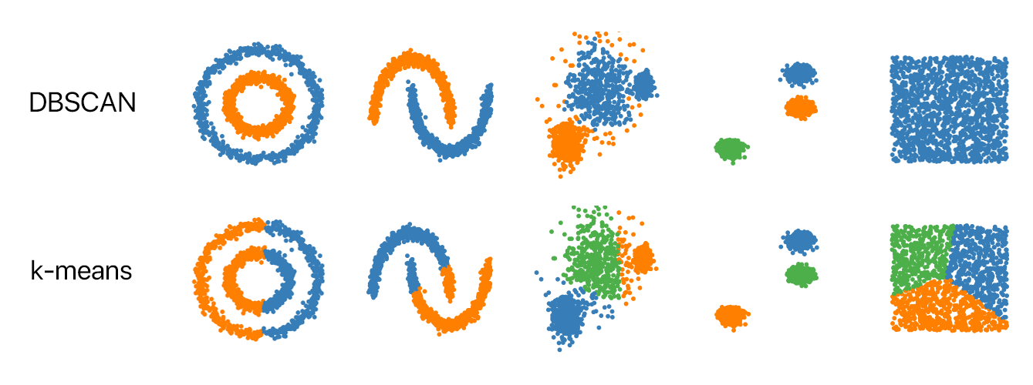
DBSCAN - Demo
Data Squad | Ensemble Learning

Slide 25
EVALUATING UNSUPERVISED LEARNING
What are good clusters?
Data Squad | Ensemble Learning

Slide 26
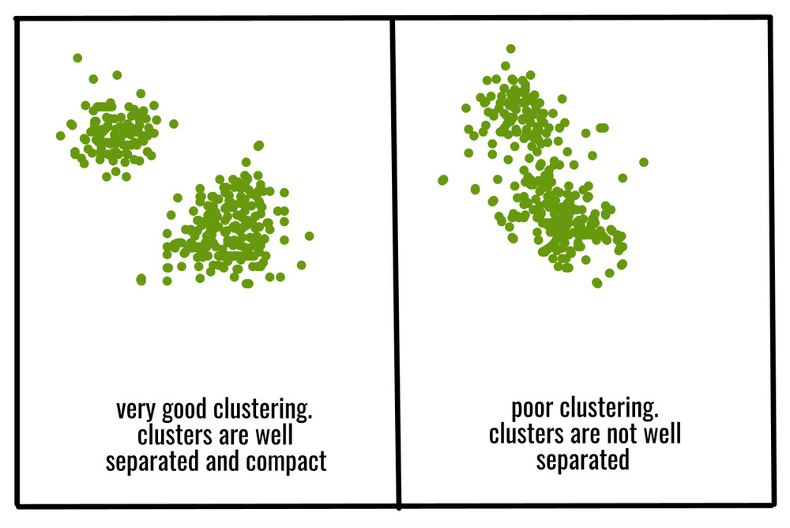
EVALUATING UNSUPERVISED LEARNING
What are good clusters?
Clusters have points tightly packed together
Clusters are far away from each other
Data Squad | Ensemble Learning

Slide 27
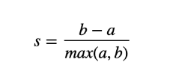
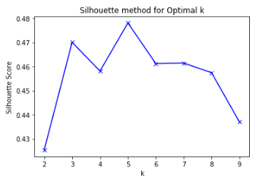
SILHOUETTE SCORE
a: mean distance between a sample point and all other points in the same cluster
b: mean distance between the sample and all other points on the nearest cluster
Data Squad | Ensemble Learning

Slide 28
SILHOUETTE SCORE
separation
density
a: mean distance between a sample point and all other points in the same cluster
b: mean distance between the sample and all other points on the nearest cluster
Data Squad | Ensemble Learning

Slide 29
SILHOUETTE SCORE
The Silhouette score : All it says is how well clusters behave in the definitional sense of clusters - e.g. how dense they are and how well separated.
Score Range | Interpretation
0.7-1.0 | Well-separated, dense clusters
0.3-0.7 | Reasonable structure, some overlap
0.0-0.3 | Weak structure, clusters not distinct
<0 | Points likely in wrong clusters
Data Squad | Ensemble Learning

